Slide 1
Greenway
Fuel your travels with knowledge.

Slide 2
Our team
01.
Intended Market
About the Project
04.
02.
Demo
Project Goals
05.
03.
Future Developments
06.
Who are we
Who did we create Greenway for
What is Greenway
Showcase of Greenway
Why did we create Greenway
Next steps

Slide 3
Who Are We?
Jash Mehta
Priyansh Shah
Pranay Kotian
Bilal Zaki
Sharjil Mohsin
Utsharga Rozario

Slide 4
Greenway
Our gas cost calculator application is designed to make it easy for you to plan your trips and save money on gas. With just a few taps, you can input your starting and ending locations, as well as your vehicle's make and model, and the application will provide you with an estimate of how much you'll spend on gas for your trip.

Slide 5
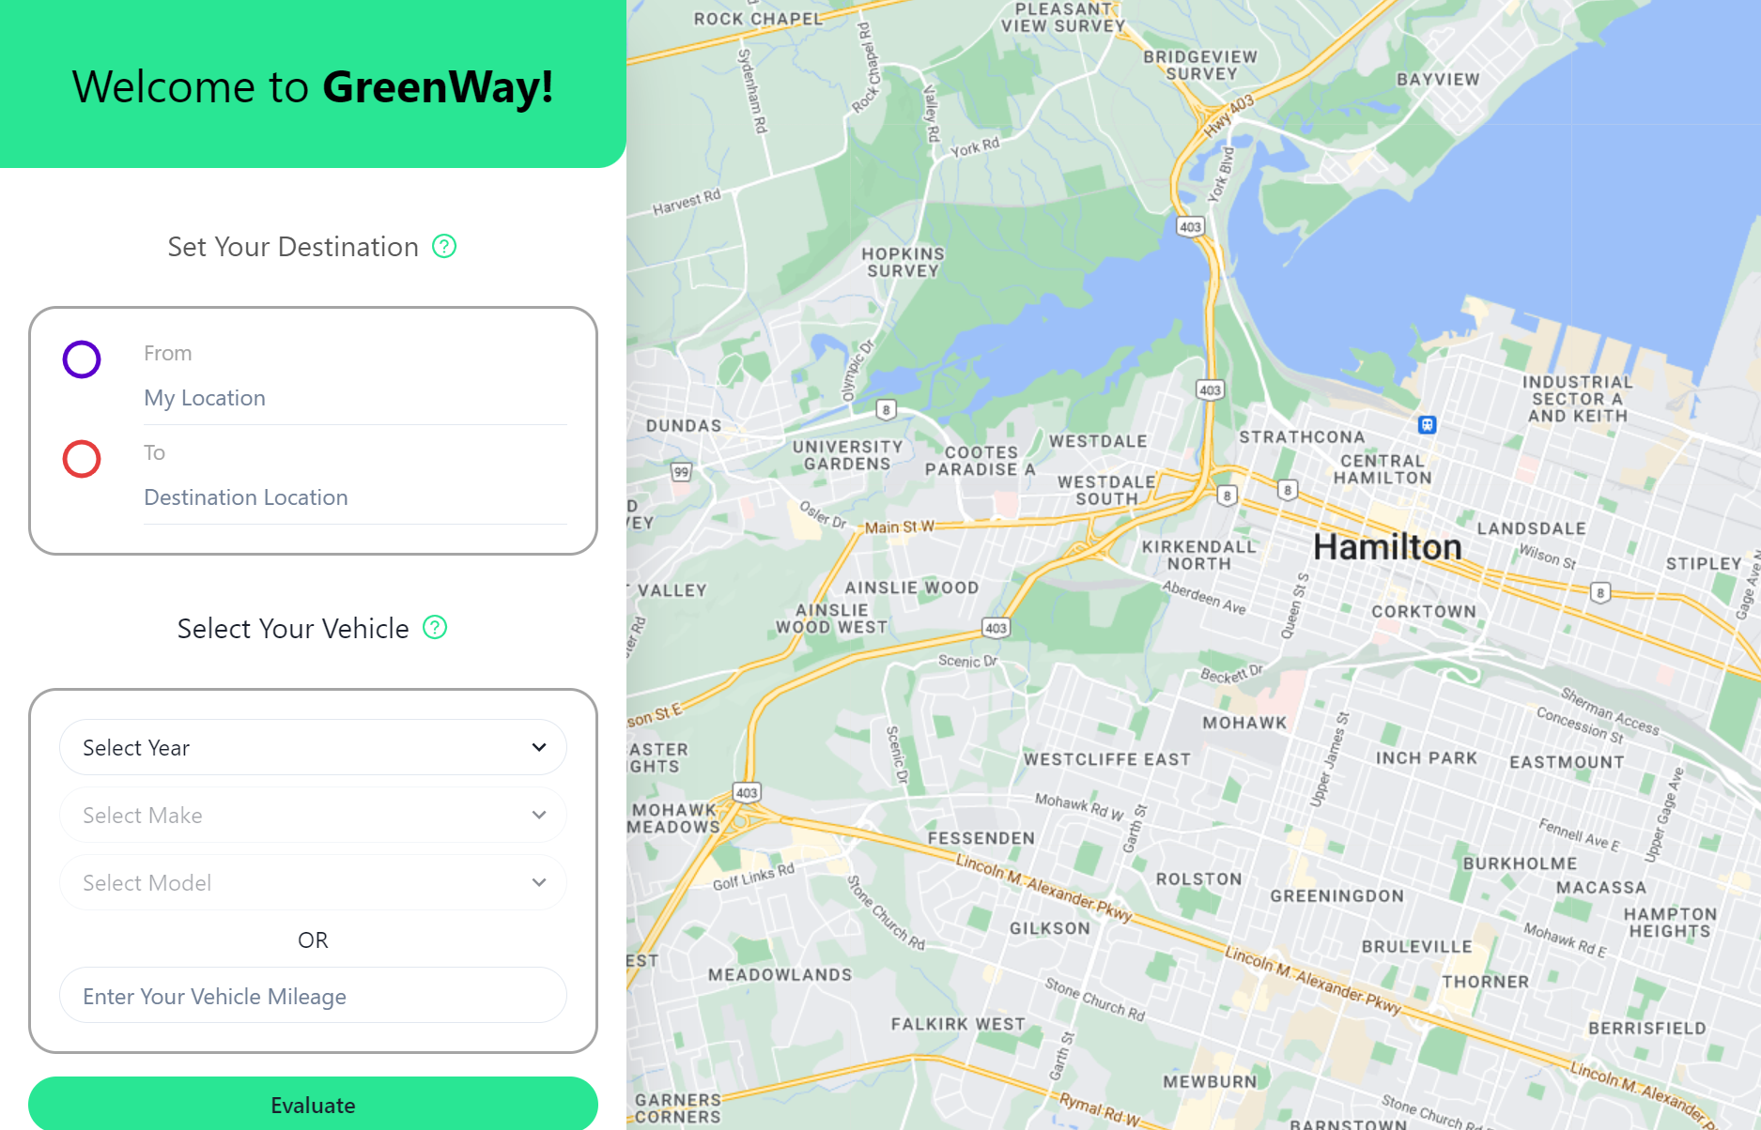
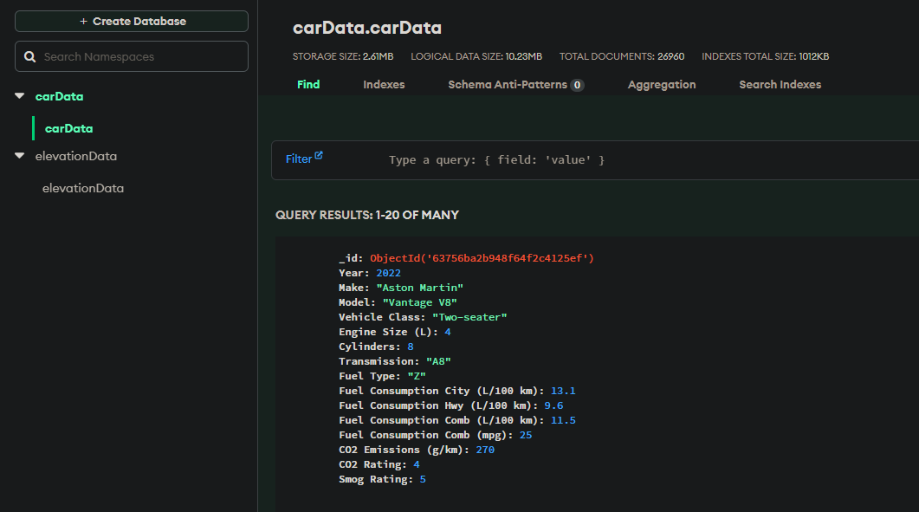
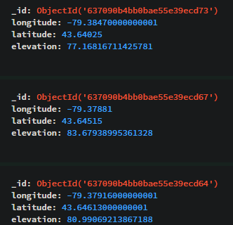
How It Works
Uses Google Maps to calculate most fuel efficient route.
Gets fuel economy from a MongoDB database we created for every gas vehicle from 1995-2023.
Determines trip cost based off fuel economy, local real time gas pricing (GasBuddy API), and changes in elevation across the route.

Slide 6
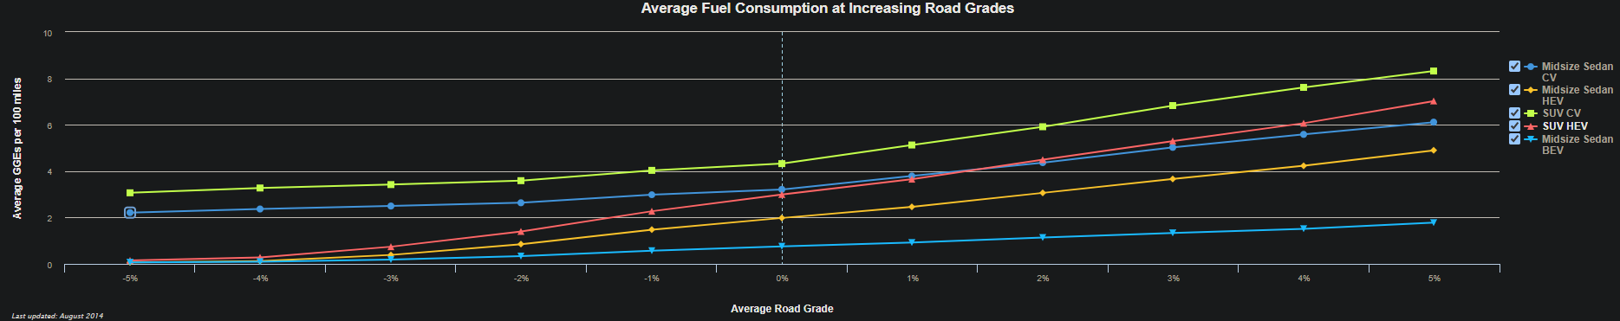
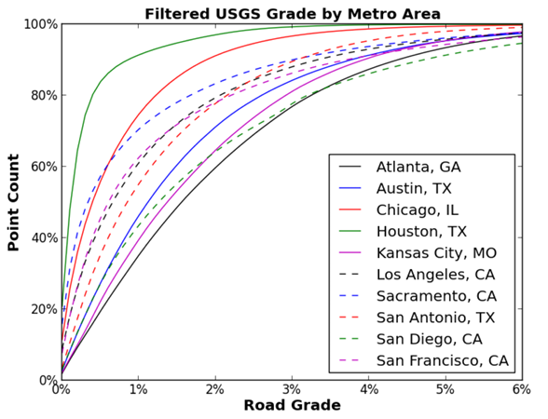
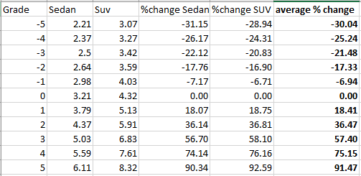
Elevation Calculations
*Data from US National Renewable Energy Laboratory

Slide 7
Project Goals
Why Create Greenway?
1. The application helps users save money on gas.
2. Users input their car info and destination for the most fuel-efficient route.
3. App uses real-time gas prices, mileage data, and terrain data to calculate trip cost.
4. App works with many types of gas vehicles.
5. App is user-friendly and easy to use.

Slide 8

Intended Market
Greenway
Product Users
The product user is anyone who can drive and hence will be using the product. The product users have the most influence on the requirements of the application and its overall development since the purpose of the application is help these users choose a cost-effective eco-friendly route for a journey.

Slide 9
Planning a road trip? Don't leave home without our gas cost calculator app. It's the perfect tool for helping you save money on gas and make informed travel decisions.
DEMO

Slide 10


Future Developments
Electric Cars
Gas Station Pins
Auto-Fill Feature
The addition of electric/hybrid cars into the catalog
The ability to see gas stations and their price on the map
Be able to auto-fill the destination boxes when a user starts to type

Slide 11
Thanks!
Do you have any questions?

